Slide 1
PROJECT TITLE
CSE7101- Capstone Project
Review-1
Batch Number:
Under the Supervision of,
Dr./Mr./Ms./Prof.
Professor / Associate Professor / Assistant Professor
School of Computer Science and Engineering
Presidency University
Roll Number | Student Name
20231CCS3004 20221CCS0012 20221CCS0036 | Syed Saifulla H Siddharth M Chinmay
Name of the Program: Btech Cyber Security
Name of the HoD: Dr. Anandaraj S P
Name of the Program Project Coordinator: Dr. Sharmasth Vali
Name of the School Project Coordinators: Dr. Sampath A K , Dr. Geetha A

Slide 2
Content
Problem Statement
Objectives
Background and Related work for title Selection
Analysis of Problem Statement
Innovation or Novel Contributions
Git-hub Link
Timeline of the Project
References

Slide 3
Content (continuation)..
Problem Statement
Objectives
Background and Related work for title Selection
Analysis of Problem Statement
Innovation or Novel Contributions
Git-hub Link
Timeline of the Project
References

Slide 4
Problem Statement Number:
Organization: Presidency University
Category (Hardware / Software / Both) : Software
Problem Description: Monitoring digital activity across multiple social media platforms can offer key insights into behavioral patterns, threat detection, and compliance for public services and governance. The absence of an integrated system for multi-platform monitoring leads to:
Difficulty in identifying suspicious activity, misinformation, and policy violations.
Delays in responding to potentially harmful posts or viral content.
No centralized repository for aggregating user activity.
Manual monitoring is time-consuming and error-prone.
Lack of automation and intelligence in current tools for real-time monitoring and alerts.
Need: A robust system capable of aggregating, classifying, analyzing, and alerting on an individual’s social media activity in real time.

Slide 5
Objectives
Aggregate and monitor activity from multiple social platforms (Facebook, X/Twitter, Instagram, LinkedIn, etc.).
Automate content-based classification (political comments, threats, misinformation).
Enable real-time notifications for flagged or anomalous activities.
Provide visualization dashboards for user activity trends.
Ensure privacy compliance and data security.
Support scalable architecture for large user bases.
Facilitate decision-making for governance and public services.
Enable future AI & ML module integration for advanced analytics.

Slide 6
Background and Related Work
Existing tools (e.g., Social Mention, Brandwatch, Hootsuite) provide monitoring, but are fragmented and costly.
Government/public agencies often lack tailored solutions for real-time and multi-platform tracking.
Related work:
  Social listening tools for brands and agencies.
  Threat intelligence platforms for cybersecurity.
Proposed system integrates aggregation, classification, alerting, and dashboarding in a lightweight, customizable solution for governance and societal challenges.

Slide 7
Analysis of Problem Statement
Current solutions:
  Are either too expensive or lack real-time cross-platform integration.
  Do not offer customizable classification for governance needs.
Challenges include privacy, large data volume, and evolving platform rules.
The proposed system:
  Solves integration and automation gaps.
  Prioritizes cost-effectiveness, modularity, and compliance.

Slide 8
Innovation and Contributions
Unified content-based classification across platforms.
Real-time notification engine for flagged activities.
Backend log storage and retention strategies.
Integrated privacy management and compliance tracking.
Interactive dashboards with trend analytics and user profiling.
Modular design for easy extension (new platforms & features).
AI/ML models for detecting anomalies, threats, and misinformation.
User-friendly UI for technical and non-technical users.

Slide 9
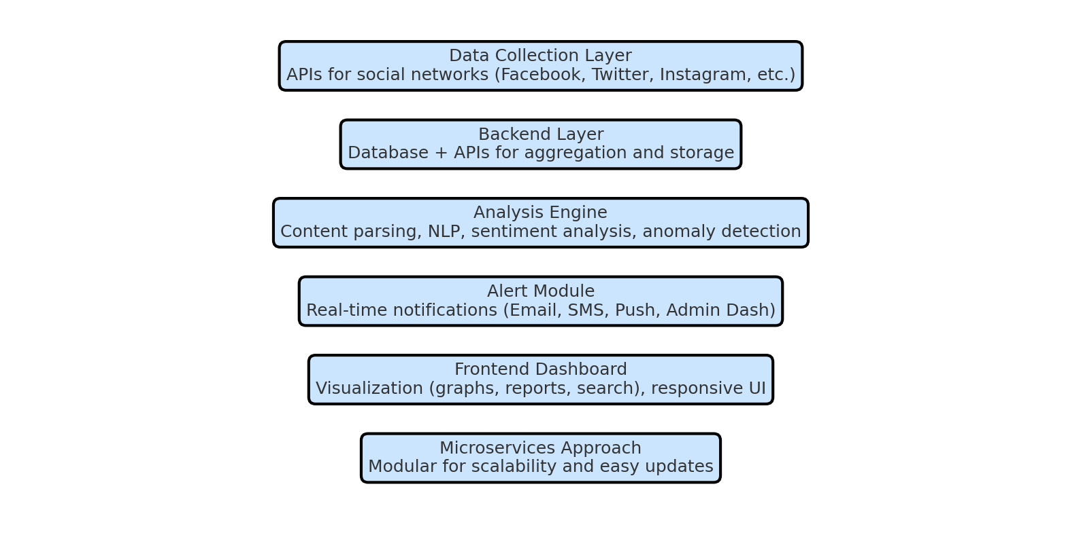
System Architecture
Data Collection Layer: APIs for social networks (Facebook Graph API, Twitter API, etc.).
Backend Layer: Database + APIs for aggregation and storage.
Analysis Engine: Content parsing, classification (NLP, keyword, sentiment analysis), anomaly detection.
Alert Module: Real-time notifications (Email, SMS, Push, Admin Dash).
Frontend Dashboard: Visualization (graphs, reports, search), responsive for desktop/mobile.
Microservices Approach: Modular for scalability and easy updates/integration.

Slide 10
Github Link
The Github link provided should have public access permission.
Github Link: https://github.com/saif8888888888888/Saifproject

Slide 11
Timeline (Gantt Chart)
Phase | Duration | Deliverables
Phase 1 - Req. Gathering/Design | Week 1-2 | Identify platforms, data sources, requirements
Phase 2 - Backend Development | Week 3-4 | API integration, DB setup, parsing algorithms
Phase 3 - Frontend Dashboard | Week 5-6 | UI for search, filtering, visualization
Phase 4 - Notification System | Week 7 | Alert triggers, E-mail/SMS integration
Phase 5 - Testing & Deployment | Week 8 | Unit, load testing, deployment
Phase 6 - Future Enhancements | Week 9 | AI detection, new platforms, reporting

Slide 12
Software and Hardware Requirements
Software Requirements:
Robust Operating System: Linux, Windows Server, or macOS (based on deployment)
Development Tools and IDEs: Visual Studio Code, IntelliJ IDEA
Database Management Systems: PostgreSQL, MySQL, MongoDB
Cloud Service SDKs for analytics and integration
API Management Tools for secure and efficient API usage
Container Orchestration Platforms: Kubernetes
Monitoring and Logging: Prometheus, Grafana
Hardware Requirements:
Minimum: Intel i5 processor, 8GB RAM, 256GB SSD
Recommended: Intel i7 processor, 16GB RAM for real-time data processing and analysis

Slide 13
References (Development)
Facebook Graph API - developers.facebook.com/docs/graph-api
Twitter API - developer.twitter.com/en/docs
Instagram Basic Display API - developers.facebook.com/docs/instagram-basic-display-api
Chart.js - Chartjs.org
Bootstrap Framework - GetBootstrap.com
Font Awesome Icons - FontAwesome.com

Slide 14
References (IEEE Paper format)
E. Ferrara et al., "The Rise of Social Bots," Communications of the ACM, vol. 59, no. 7, pp. 96-104, 2016.Review1-ppt.pdf
A. Bessi, E. Ferrara, "Social media and misinformation," Online Social Networks and Media, vol. 1, pp. 66-73, 2017.
S. Z. A. Shah et al., “Threats, attacks and countermeasures in web application security,” IEEE Access, vol. 7, pp. 153779–153795, Oct. 2019.
H. Tahir et al., "Towards secure social media monitoring frameworks," IEEE ICET, pp. 1–6, Dec. 2020.

Slide 15


